Slide 1
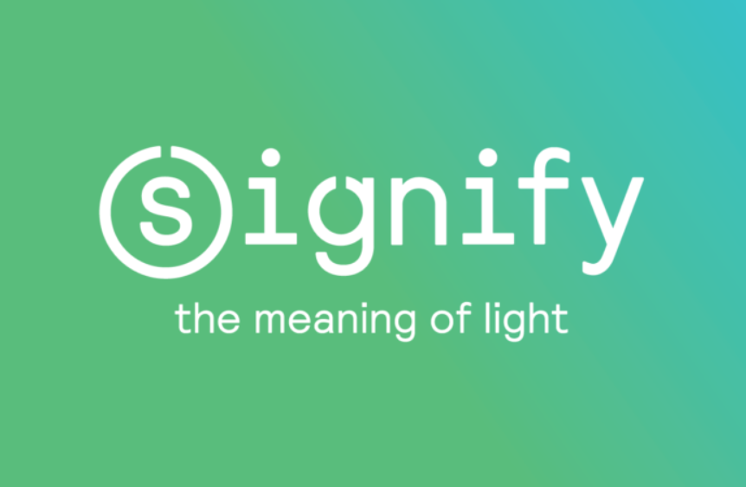

Slide 2




Our Vision
1
2
To Create An Course Registration System Using Full Stack Development Tools And Technologies, Where A Student Can Register For Course, View Grade Card And Change Password Professor Can View Enrolled Students And Add Grades Admin Can Approve Student, Add Professor, Generate Reportcard, And Assign Professor To Course
Quality
Security
3
4
Interactivity
Speed
Notes:
User satisfaction and brand value

Slide 3
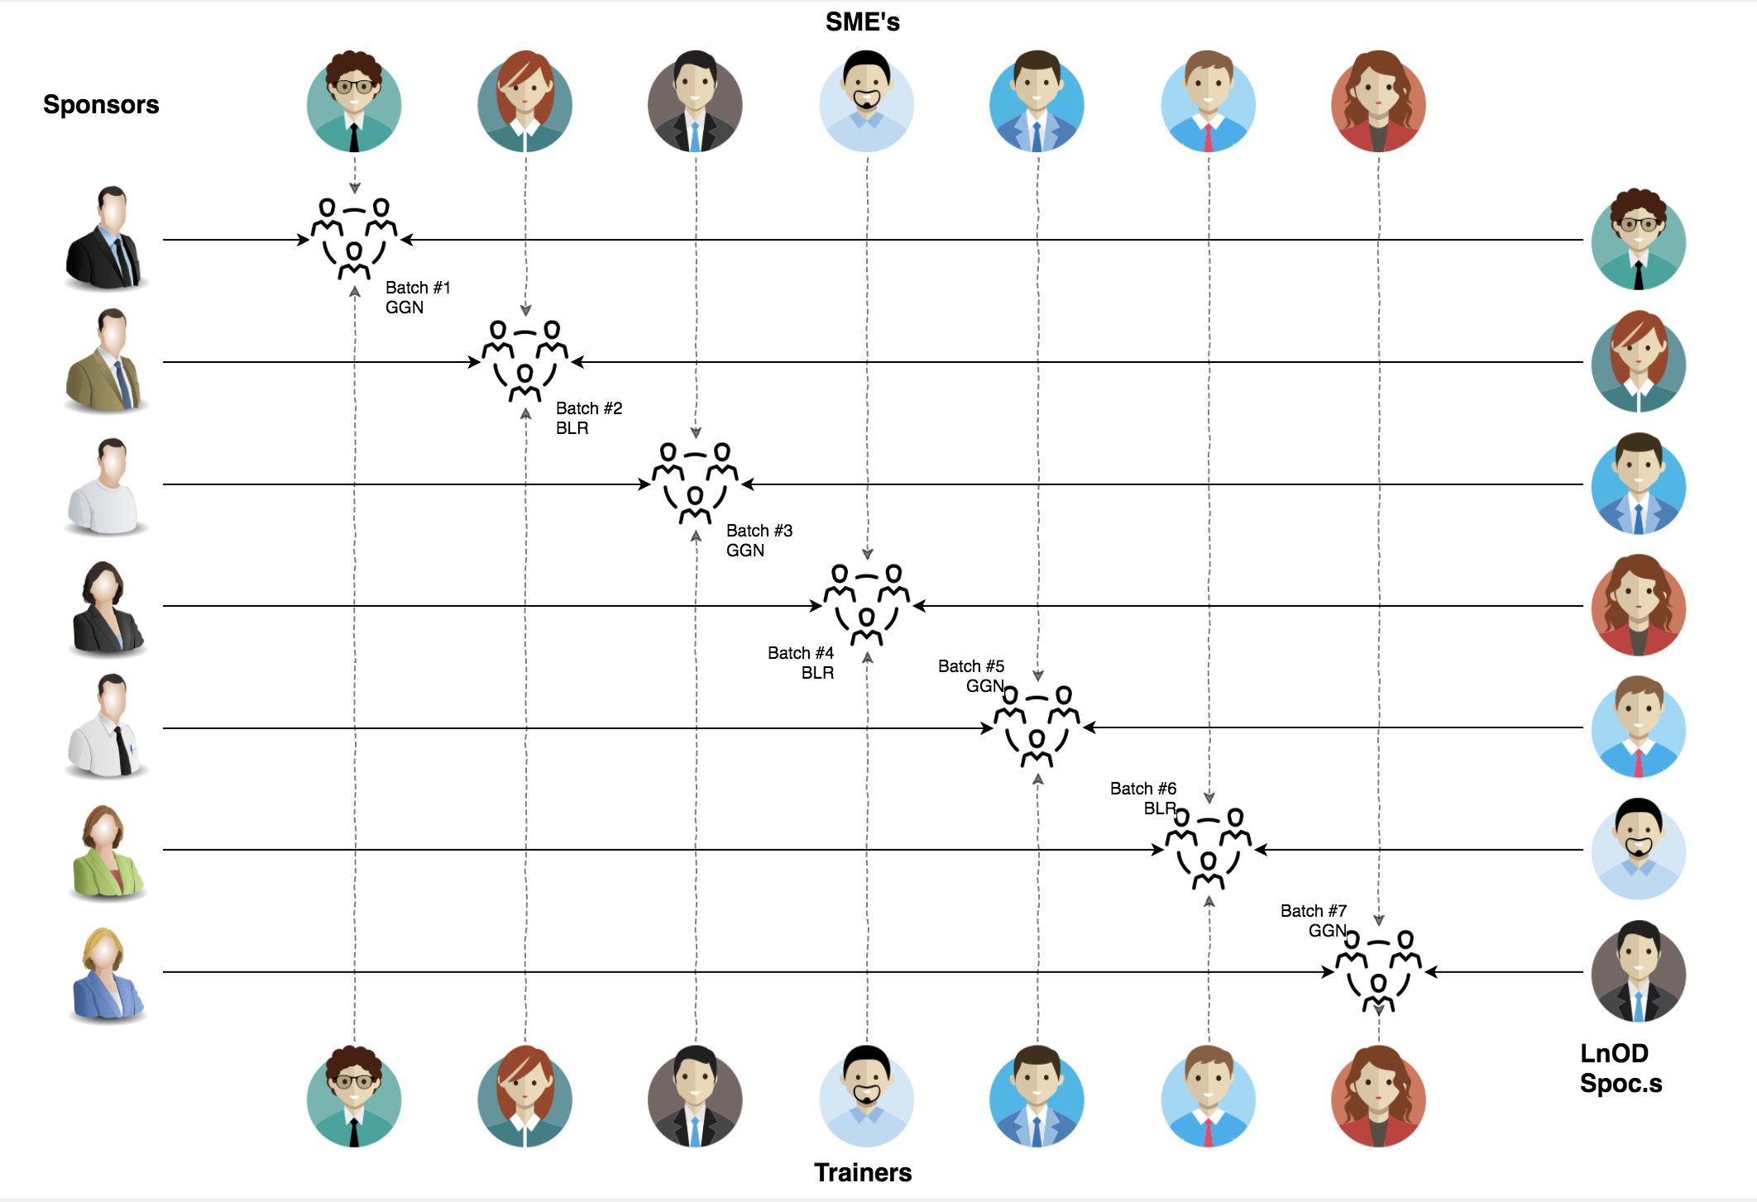
Stakeholders
1. Sponsors Signify Innovation Labs
2. SME’s Amit Balyan
3. Coordinator Seema Sandeep
Shwetha Kumari

Slide 4
3 WEEKS OF TRAINING + PROJECT DEMO
15 DAYS
360 HOURS
21600 MINUTES
1296000 SECONDS
LIMITLESS KNOWLEDGE

Slide 5
ABOUT
The Updated System Enables Students To Register For Courses And View Their Report Cards Using Personal Computers Connected To The Campus Lan.
Additionally, Professors Have Access To The System, Which Allows Them To Register For Teaching Courses And Record Grades.
To Finish The Development Process To A Close, We Began By Familiarizing With Git Commands. Next, We Built The Core Structure Of The System Using Java.
The Backend Was Powered By Spring, And The Database Was Managed Using Mysql. We Used Postman To Test The Api, While The Frontend Was Developed With Typescript For Angular.

Slide 6
15 days & the D day
3 weeks plan
Everyday Discussion about topics / Technologies/ doubt clearance .
Every day with SME/Trainer discussion of Project progress & transformation based on backend Technologies

Slide 7
Why We Used
Git 🡪version Control System That Allows Developers To Manage And Track Changes To Their Codebase Over Time Collaboration, Version Control, Branching And Merging, Backup And Recovery.
Java 🡪 Provides A Wide Range Of Tools And Features For Full Stack Development Scalability, Robustness And Reliability, Rich Libraries And Frameworks.
Spring Boot🡪 Creates A Backend Api That Can Handle Requests And Provide Responses To Frontend Applications. Dependency Injection, Simplified Development, Integration, Modularity.

Slide 8
Mysql🡪 Open-Source Relational Database Management System Scalability, Performance, Compatibility, Open-Source.
Postman🡪 Postman Is An Api Client Used To Develop, Test, Share And Document Apis Test Api Endpoints, Automation, Debugging
Typescript And Angular🡪 It Is A Superset Of Javascript That Adds Optional Static Typing And Other Features To The Language. Angular Is Open-Source Front-End Framework. Type Safety, Tooling And Compatibility. Modular Architecture , Two-Way Data Binding And Cross-Platform Development.

Slide 9

Our Journey
Notes:
Time - 2 mins

Slide 10

To Accomplish This Project
Initially, We Began By Acquainting Ourselves With Fundamental Git Commands To Facilitate Collaborative, Non-Linear Development. Following That, We Proceeded To Install Essential Software Tools Required For The Development Process. Like :- Git, Java, Spring Tool Suite[Sts], Mysql, Visual Studio Code Etc..
Later Used Java To Develop The Core Structure Of Our Project, And We Opted Mysql As The Database For Our Backend. Initially, We Tested All The Services Using Hardcoded Data, But Once We Integrated With The Database, We Tested Them Using User Input. Here We Used Spring And Mysql.
Additionally, We Developed The Corresponding Rest Controller Services Using Post And For The Frontend Development Part Used Angular. 5

Slide 11
CRS
Mindset
Process
5
CRS Project
Tools
4
Adapting to a developer
Mindset
Comprehend
3
Design Thinking
2
JAVA
1
Understanding Project Goals

Slide 12
Our Team
Shatakshi Singh
Vaanmati
Srinivasan
Pranshul
Chaudhary
Rashi Kanodia
Anushka Prasad
Shaurya Agrawal

Slide 13

Team Structure
Notes:
Time – 2 mins

Slide 14

The Course Registration System
The updated system enables students to register for courses and view their report cards using personal computers connected to the campus lan.
Additionally, professors have access to the system, which allows them to register for teaching courses and record grades.
To finish the development process to a close, we began by familiarizing with git commands. next, we built the core structure of the system using java.
The backend was powered by spring, and the database was managed using mysql. we used postman to test the api, while the frontend was developed with typescript for angular.
Notes:
Time – 3 mins

Slide 15

Engineering Practices
Notes:
Time – 5 mins

Slide 16
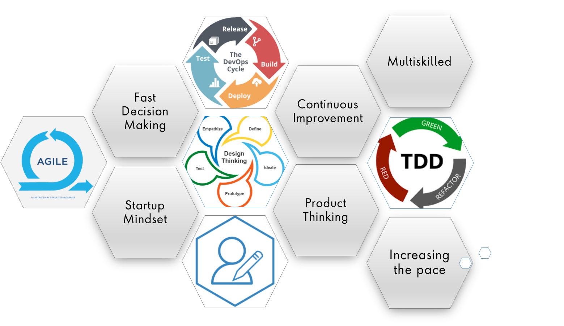
Notes:
Product Thinking (Design Thinking, Requirement Analysis, )
Multi Skilled (Frontend, Backend, DevOps)
Fast Decision Making (Agile)
Increasing the Pace (Automation CI/CD)
Startup Mindset (Agile)
Continuous Improvement (Retros)

Slide 17
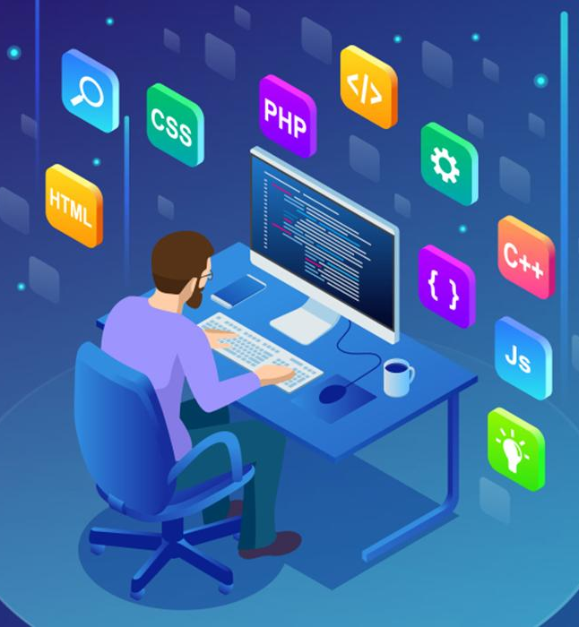
Tech Stack
Notes:
Time – 2 mins

Slide 18




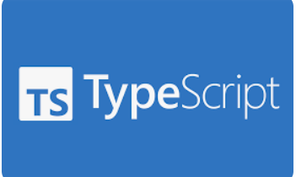



Backend
Data
Code Editor
Frontend
Core Language
SQL Database
Visual Studio Code
Open Source
Framework
Spring Application
API Platform
Notes:
Time – 1 min

Slide 19

Development
Notes:
Time – 1 min

Slide 20
Requirement understanding
Research and analysis
Estimation
Sprint Planning
Spring Grooming
Delivery
Sprint Implementation
LLD
Development
Code Review
Commit
Integrate
Deploy
Test
Notes:
Time – 1 min

Slide 21

Challenges & Learnings
Notes:
Time – 2 mins

Slide 22

Demo
Notes:
Time –
Architecture – 5 mins
NFR Dashboard – 3 mins
Demo – 10 mins
1. Show the Responsiveness and Wave tool first

Slide 23

Questions
Notes:
Time - ?

Slide 24
Thank you
Notes:
Time – After this show the testimonial video. 1 min

